Slide 1
Handling Production Issues
How to make your boss think you’re Superman

Slide 2
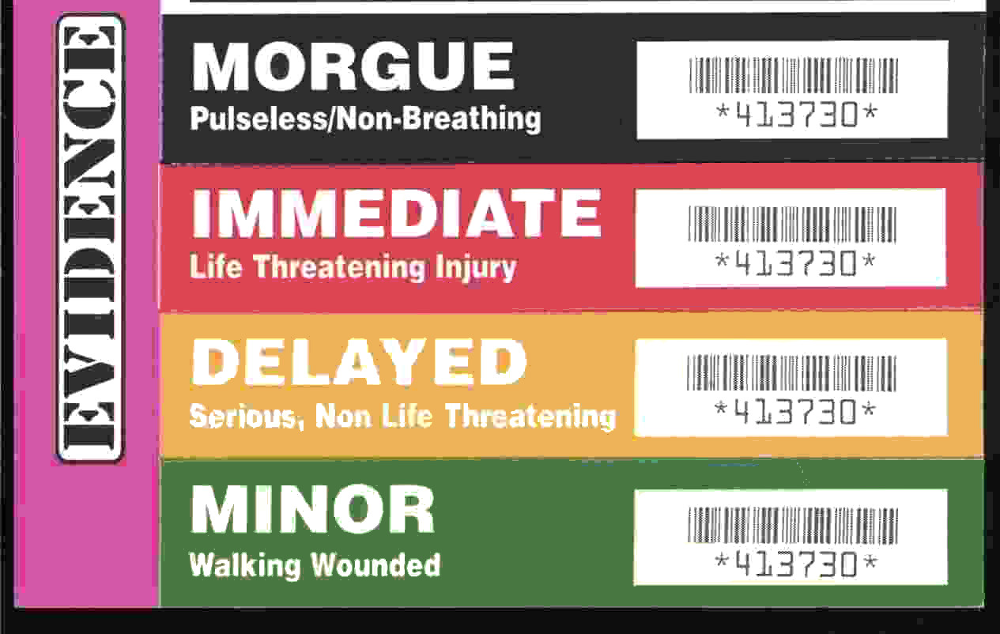
Triage - the sorting of patients (as in an emergency room) according to the urgency of their need for care
http://www.merriam-webster.com/dictionary/triage

Slide 3
Triage Steps
What environment?
How many people are affected?
What are the symptoms?
Does it happen all the time or intermittently?
Try to narrow down where the issue is occurring

Slide 4
Debugging
Gather details
IDs
Time of occurrence
Expected behavior
Actual behavior
Reproducible?
Is it safe to reproduce the issue?
Check the logs
Check all the logs
Increase logging level or try other tracing (e.g. IIS)
Memory dump?

Slide 5
Logging
Don’t log too much
Don’t log too little
Info = normal log level for production
Debug/Verbose = local/dev/sometimes QA
Log exceptions
AppDomain.CurrentDomain.UnhandledException
TaskScheduler.UnobservedTaskException
Event Log
Contextual information is vital
IDs
“Call has ended” vs “Call 12345 has ended with status Transferred”

Slide 6
Diagnose the issue
“The tool isn’t working”
Type : System.Data.SqlClient.SqlException
Message : A network-related or instance-specific error occurred while establishing a connection to SQL Server. The server was not found or was not accessible. Verify that the instance name is correct and that SQL Server is configured to allow remote connections.

Slide 7
Memory Dumps
Memory Leaks
Use a profiler when possible
Random crashes
Check the logs first
Deadlocks
Infinite loops

Slide 8
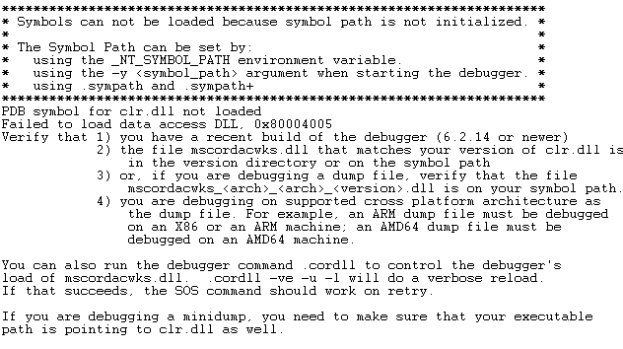
Configuration

